Slide 1
Templates

Slide 2
A template is a blueprint or formula for creating a generic class or a function.
It allows you to write generic programs.
Generic programming is a technique where generic types are used as parameters in algorithms so that they can work for a variety of data types.
C++ adds two new keywords to support templates: ‘template’ and ‘typename’. The second keyword can always be replaced by keyword ‘class’.

Slide 3
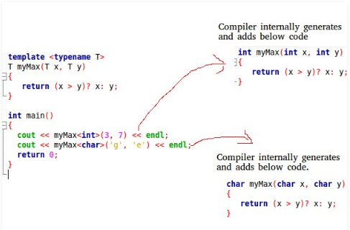
How templates work?

Slide 4
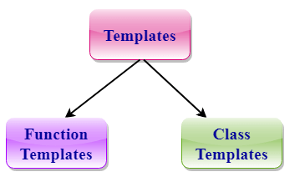
The concept of templates can be used in two different ways:

Slide 5
Function Templates
Function templates are special functions that can operate with generic types. This allows us to create a function template whose functionality can be adapted to more than one type or class without repeating the entire code for each type.

Slide 6
Syntax of Function Template
template < class/typename Ttype>
ret_type func_name(parameter_list)
{
// body of function.
}
Where Ttype: It is a placeholder name for a data type used by the function. It is used within the function definition. It is only a placeholder that the compiler will automatically replace this placeholder with the actual data type.
Class/typename: A class or typename keyword is used to specify a generic type in a template declaration.

Slide 7
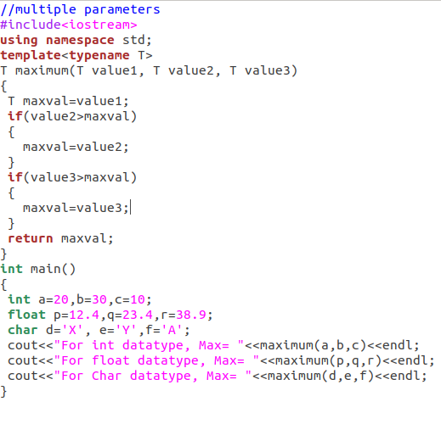

Slide 8
Function Templates with Multiple Parameters
We can use more than one generic type in the template function by using the comma to separate the list.
Syntax :
template<class T1, class T2,.....>
return_type function_name (arguments of type T1, T2....)
{
// body of function.
}

Slide 9
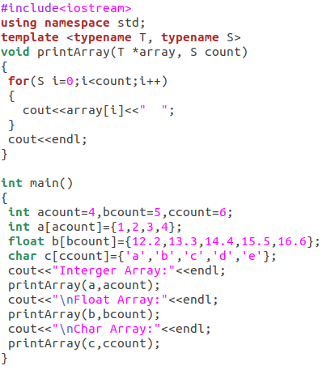

Slide 10
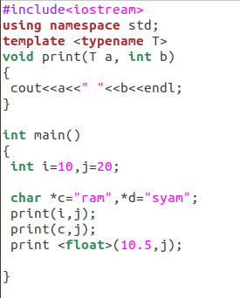

Slide 11
CLASS TEMPLATE
Class Template can also be defined similarly to the Function Template. When a class uses the concept of Template, then the class is known as generic class.
Syntax
template<class Ttype>
class class_name
{
.
}
Ttype is a placeholder name which will be determined when the class is instantiated. We can define more than one generic data type using a comma-separated list. The Ttype can be used inside the class body.

Slide 12
we create an instance of a class
class_name<type> ob;
where class_name: It is the name of the class.
type: It is the type of the data that the class is operating on.
ob: It is the name of the object.

Slide 13
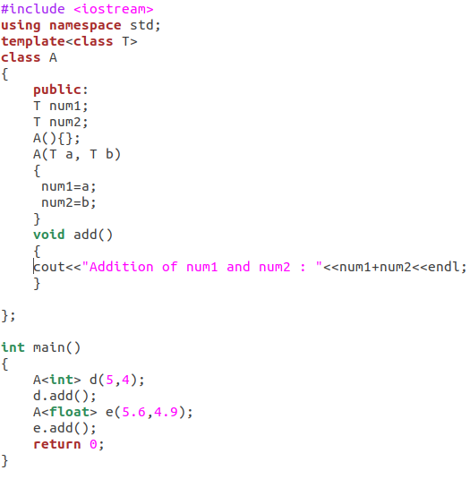

Slide 14
CLASS TEMPLATE WITH MULTIPLE PARAMETERS
We can use more than one generic data type in a class template, and each generic data type is separated by the comma.
Syntax:
template<class T1, class T2, ......>
class class_name
{
// Body of the class.
}

Slide 15
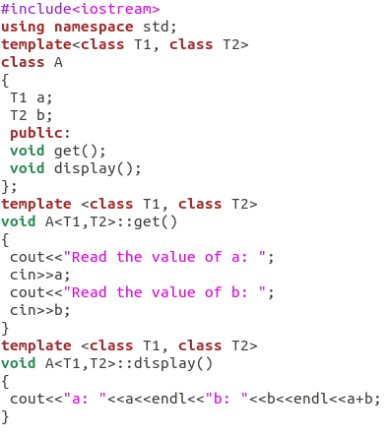
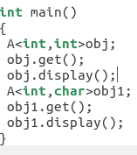
example

Slide 16
Nontype Template Arguments
The template can contain multiple arguments, and we can also use the non-type arguments In addition to the type T argument, we can also use other types of arguments such as strings, function names, constant expression and built-in types. Let' s see the following example:
template<class T, int size>
class array
{
T arr[size]; // automatic array initialization.
};

Slide 17
Arguments are specified when the objects of the class are created:
array<int, 15> t1; // array of 15 integers.
array<float, 10> t2; // array of 10 floats.
array<char, 4> t3; // array of 4 chars.

